Slide 1
DeFi Week
Coursebook & Workbook Preview
📖🔭

Slide 2
What is DeFi?
Decentralised Finance
Open to everyone
“Banking the unbanked”
No credit checks, no rejections
Trustless
No intermediaries
Total Value Locked (TVL) in DeFi ecosystem

Slide 3
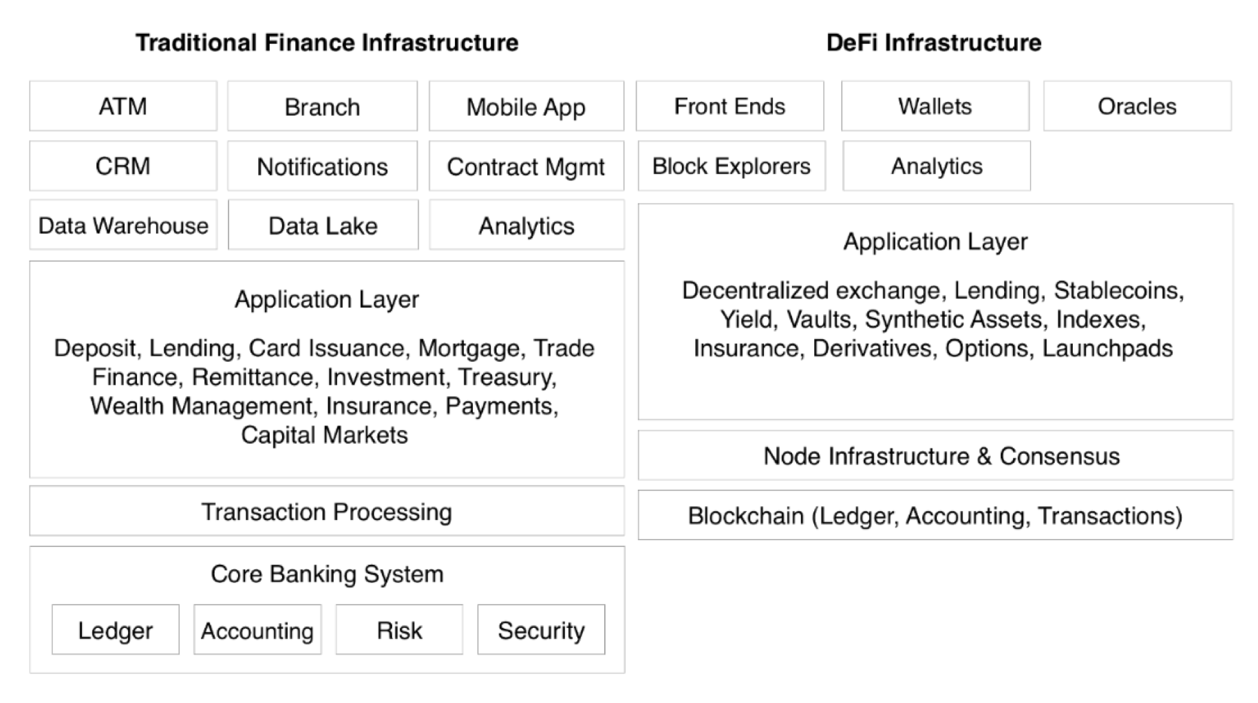
DeFi vs TradFi
What are the key differences between decentralised and traditional finance?
Interaction Layer
Application Layer
Execution Layer

Slide 4
DeFi Application Layer
Tokens — what are tokens?
Looking at tokens in the context of DeFi
ERC20, ERC271… methods, events…

Slide 5
Coins vs Token
Cryptocurrencies — tokens vs coins
Utility tokens, exchange tokens, governance tokens, meme coins
Bitcoin vs Ethereum vs BTC vs ETH
Altcoins
Dogecoin
Stablecoins

Slide 6
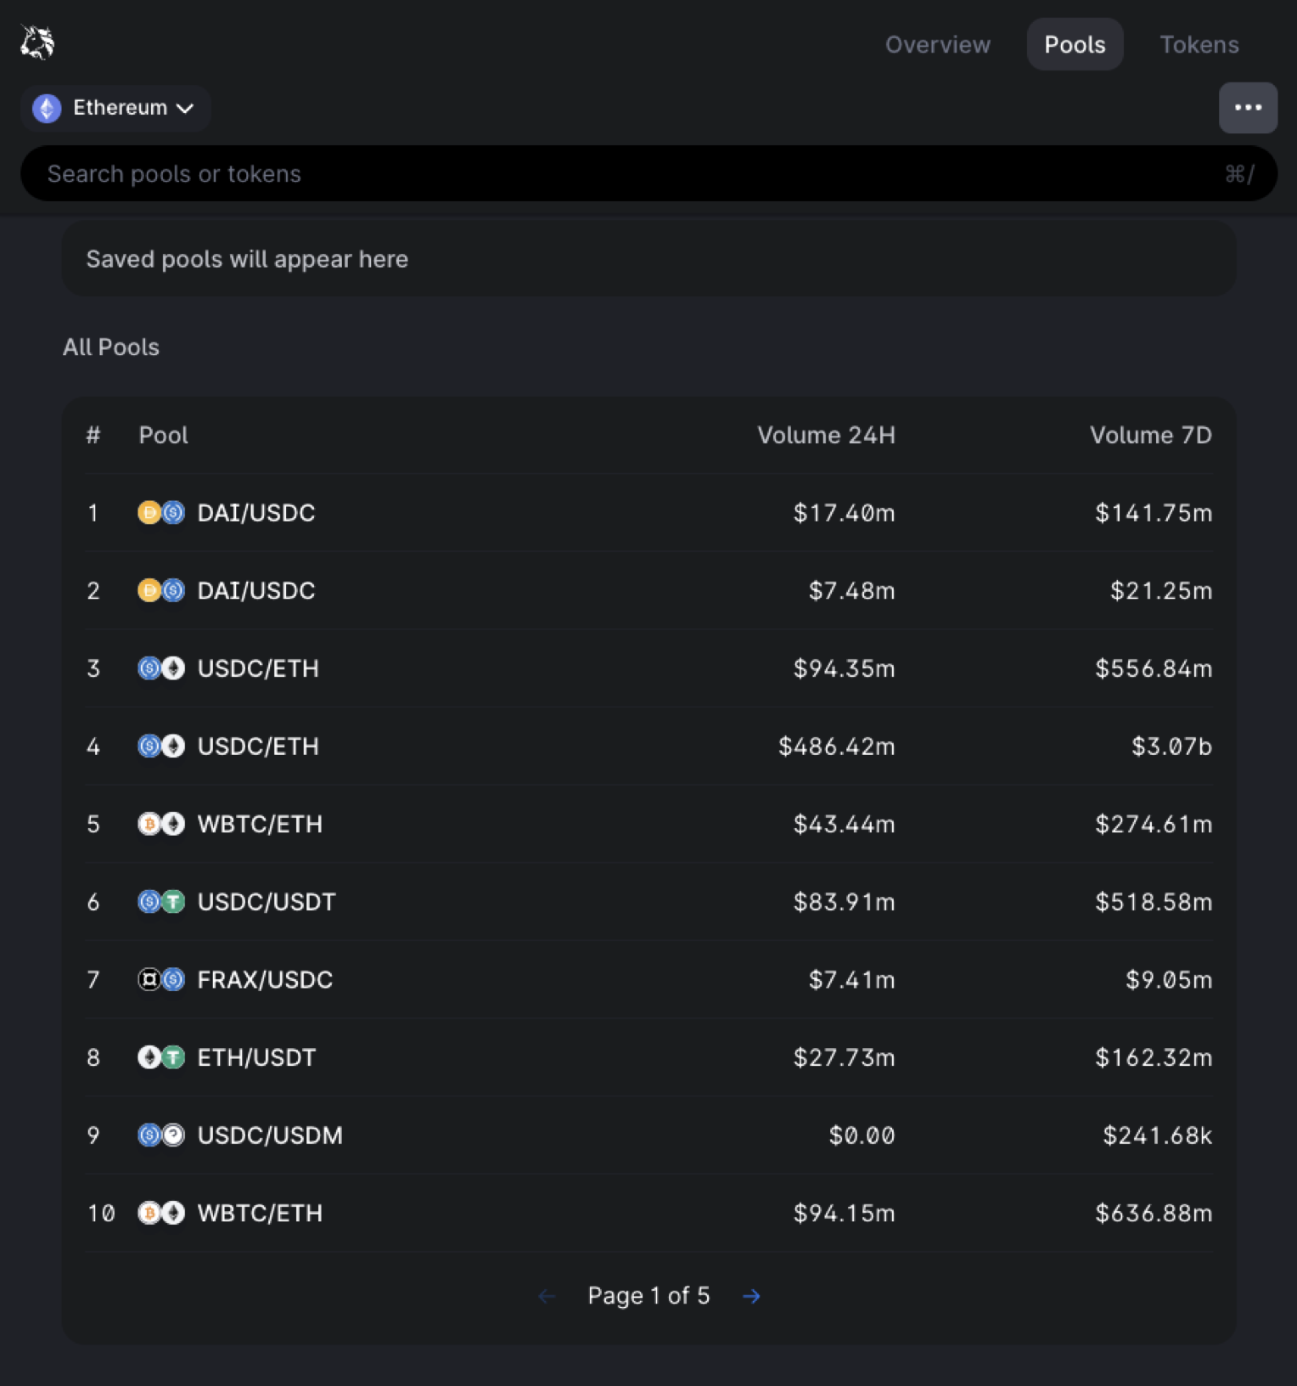
Decentralised Exchanges
Classic order-book based trading
P2P
Automated Market Maker (AMM) swaps
P2Pool2P
Liquidity providers
Protocol fees/rewards
“Tokenomics”

Slide 7
Lending & Borrowing
Would you lend money to a faceless wallet over the blockchain?
How would we guarantee they’d pay it back?
Over-collateralization
Mechanics of how this is facilitated by code

Slide 8

Oracles
The link between the blockchain and the real world
Price feeds
Weather data
Data from other blockchains
Truly random numbers
The Oracle Problem
Decentralised data feeds
https://www.cloudflare.com/learning/ssl/lava-lamp-encryption/

Slide 9
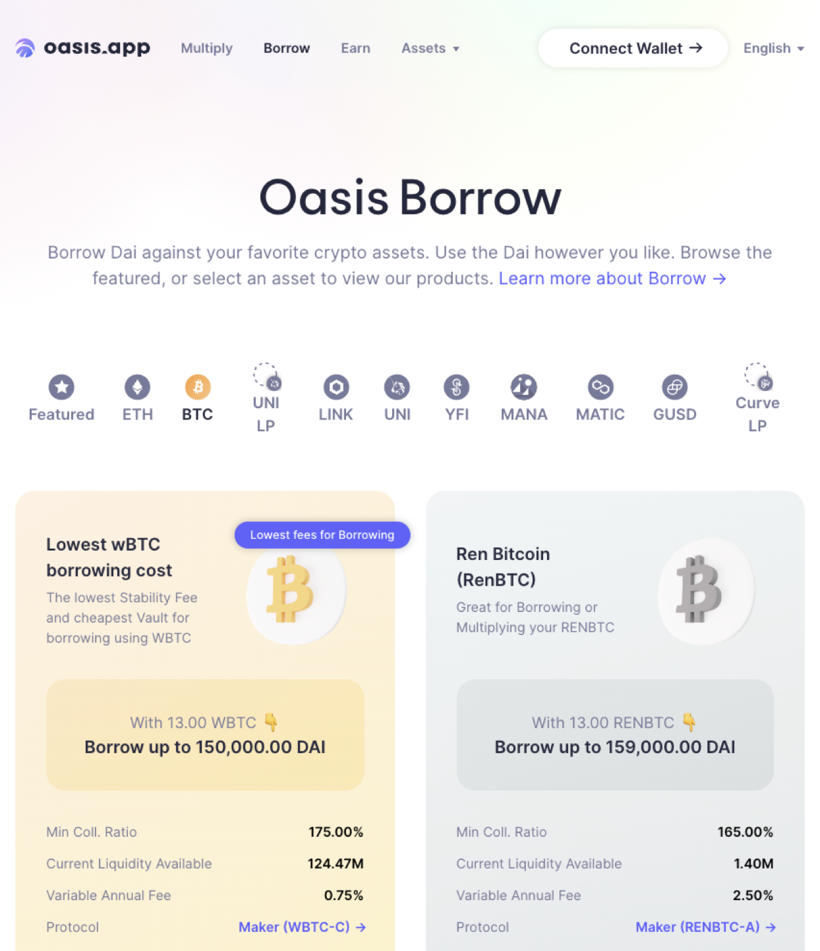
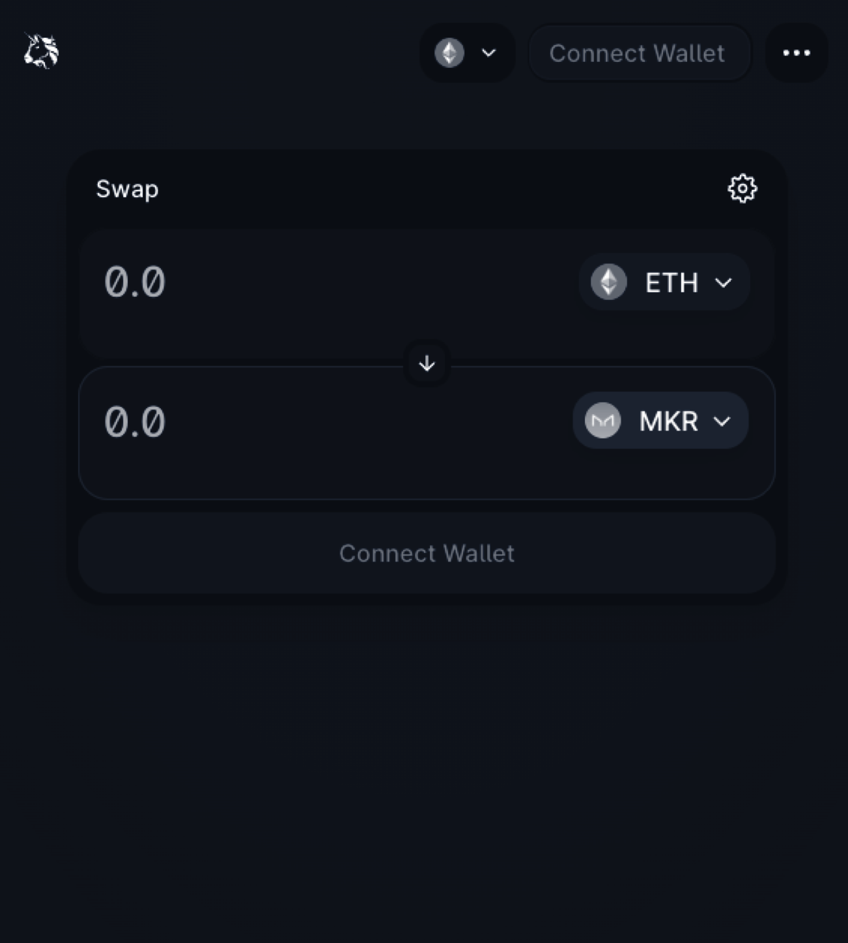
Popular DeFi Protocols
MakerDAO
Uniswap
ENS

Slide 10
Future Developments
Crypto as legal tender?
Banned outright?

Slide 11
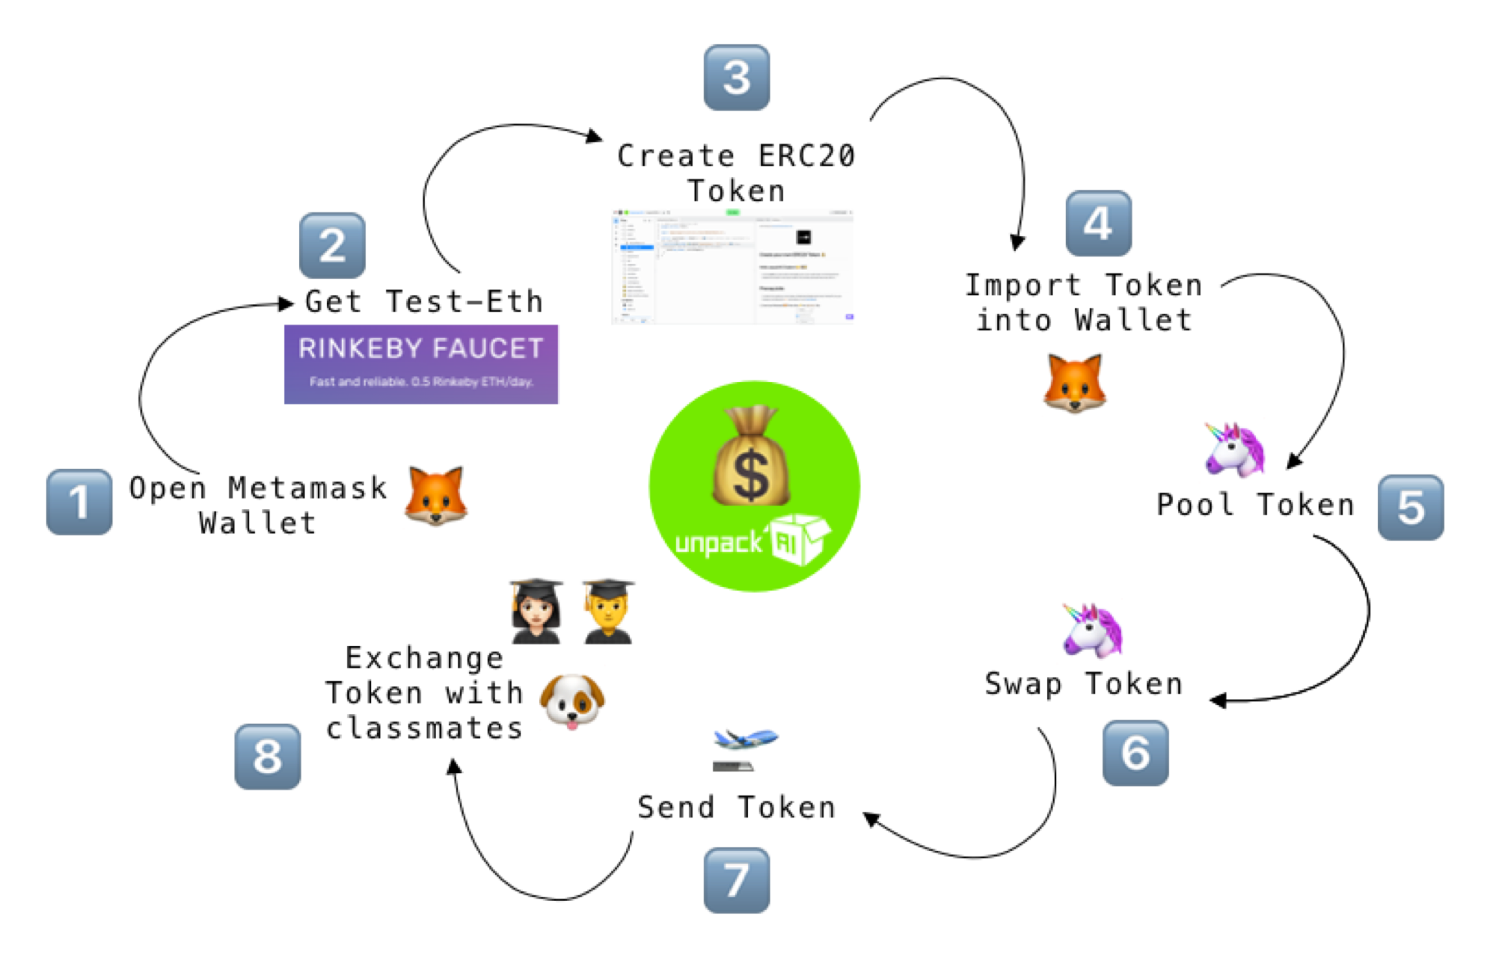
👩🏾‍💻 Assignment:
Create Your Own Cryptocurrency
Create your own ERC-20 token
Interact with the blockchainvia Metamask
Meet web3.py library
Learn the many units of ETH
Make a txn using ENS

